Slide 1
Arabic Poetry

Slide 2
Arabic Poetry
This dataset has been referred from Kaggle
Description
The data set contains about 55K Arabic poem from different Categories with poets from different countries and era.
in the data you can find modern Arabic poems from 19 different countries like
('الإمارات', UAE), ('البحرين', Bahrain), ('الجزائر', Algeria)
also you can find poems from 9 different eras like
(العصر الجاهلي , pre-islamic-period) (العصر الإسلامي , Islamic-era)

Slide 3
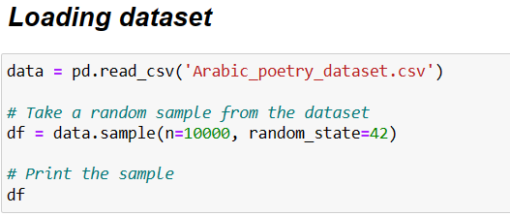
Read dataset

Slide 4
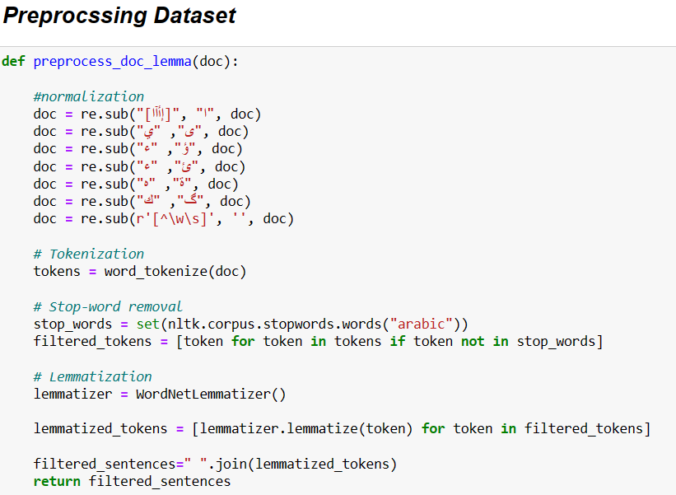
Preprocssing dataset

Slide 5
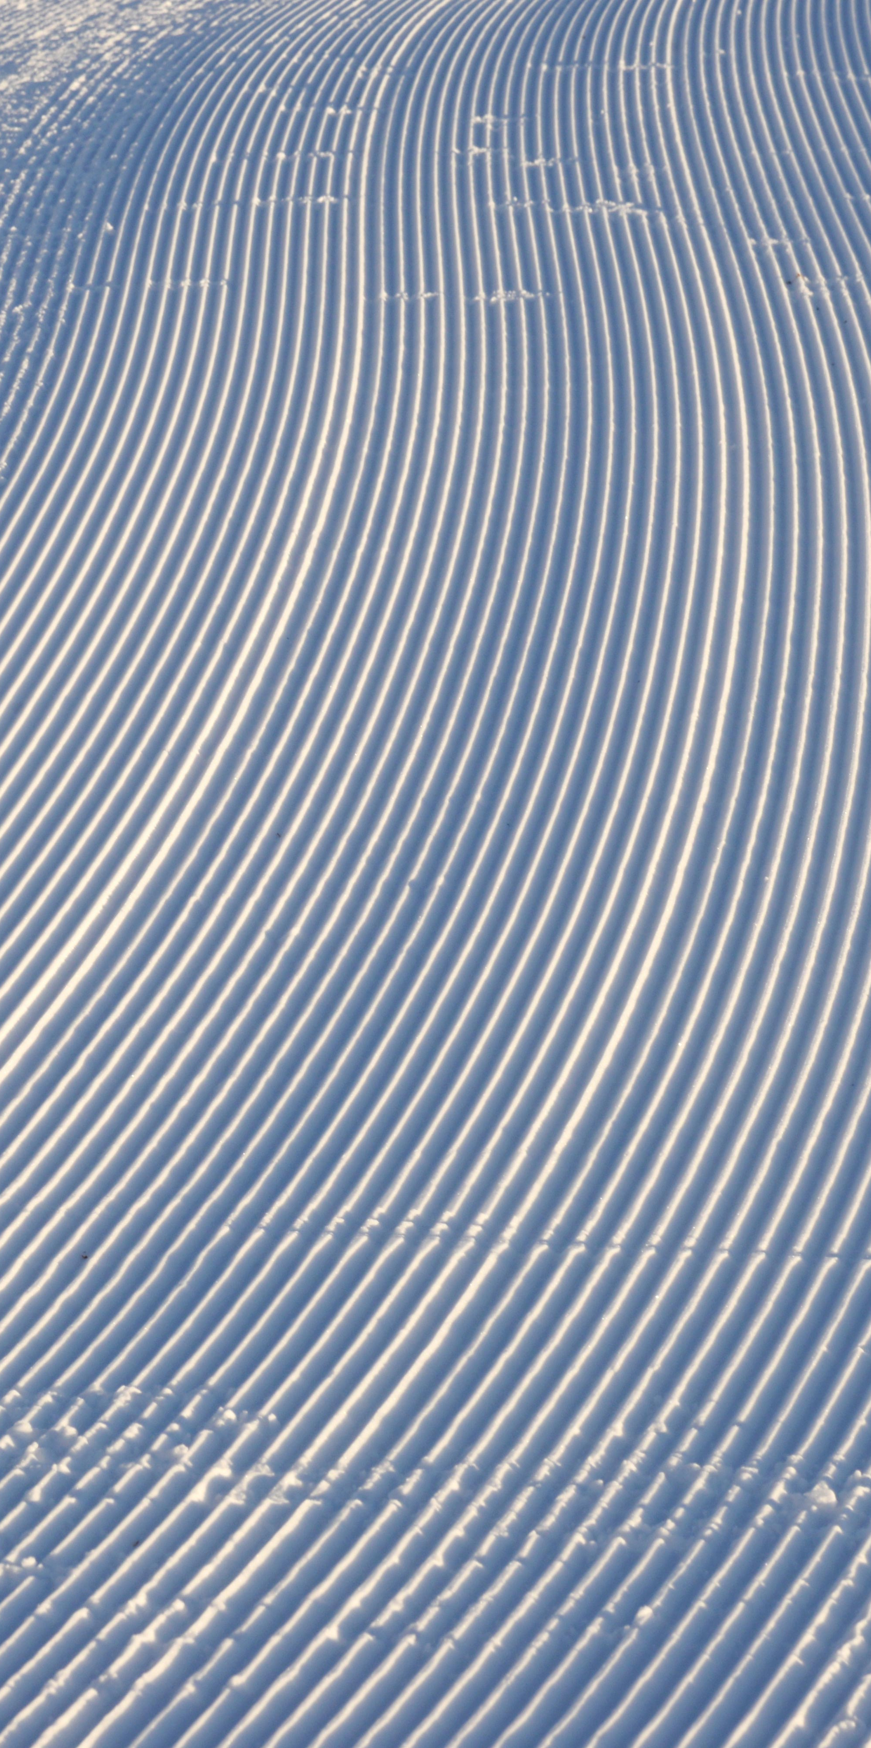
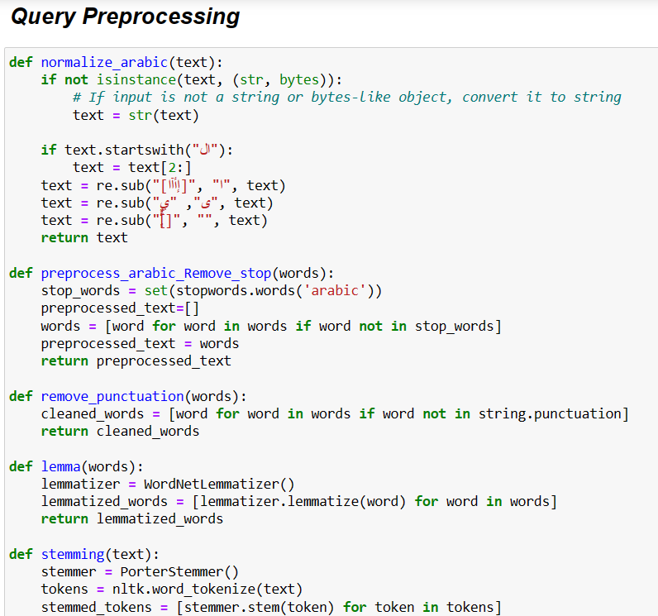
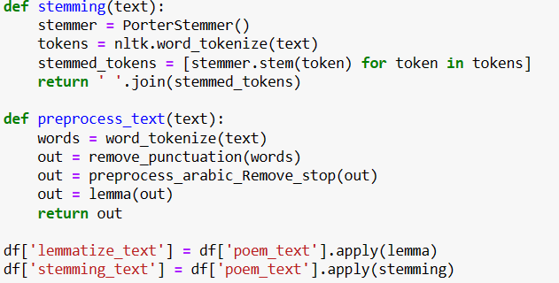
Query Preprocessing

Slide 6
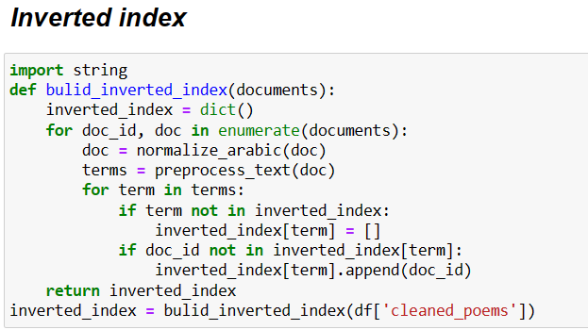
Inverted index

Slide 7
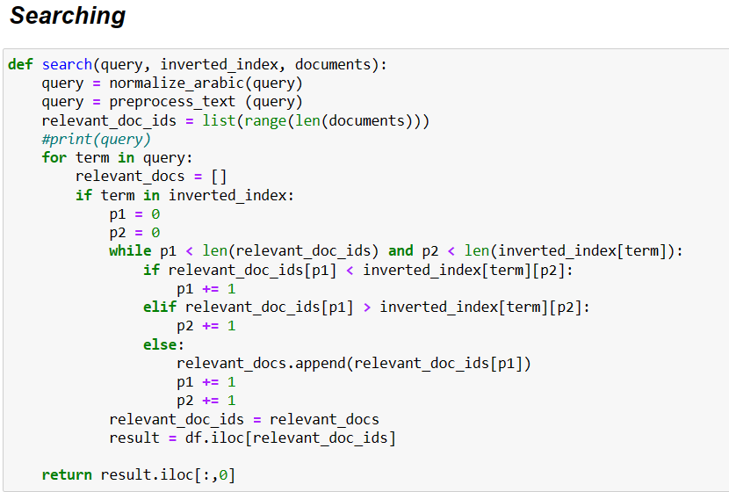
Searching

Slide 8
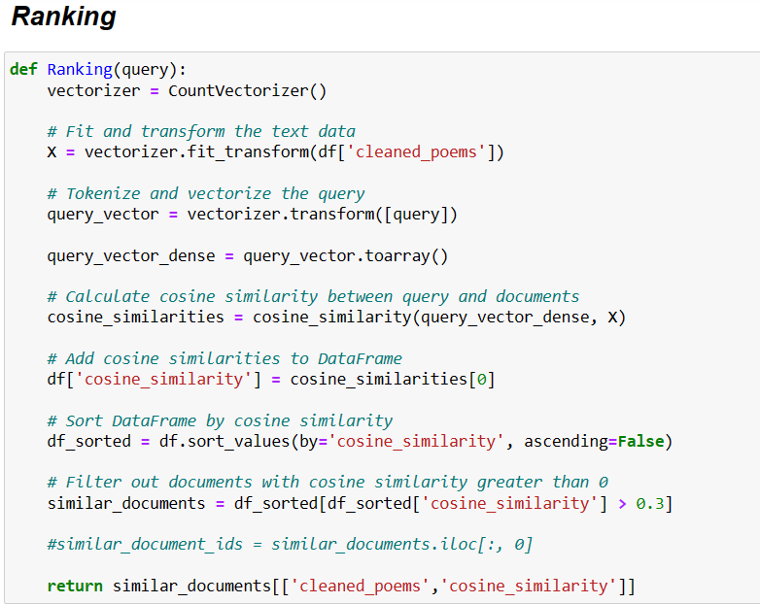
Ranking

Slide 9
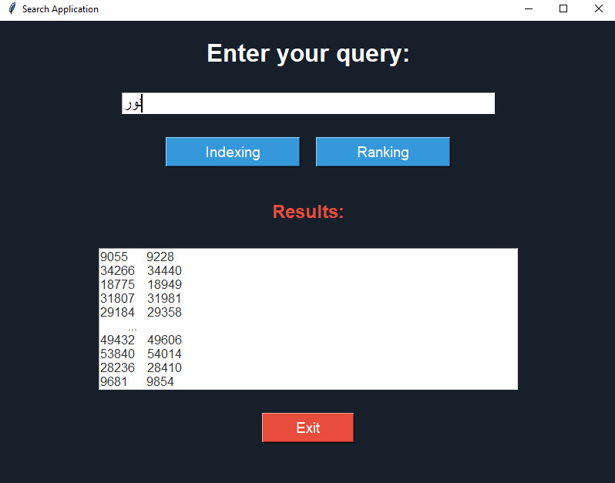
GUI

Slide 10
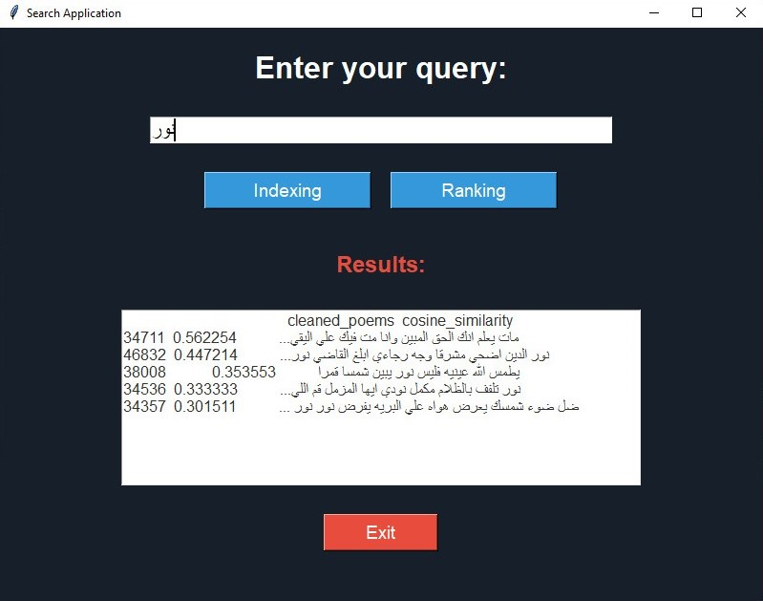
GUI

